Slide 1
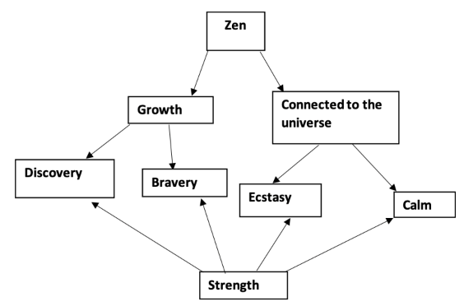
Josh Adler

Slide 2
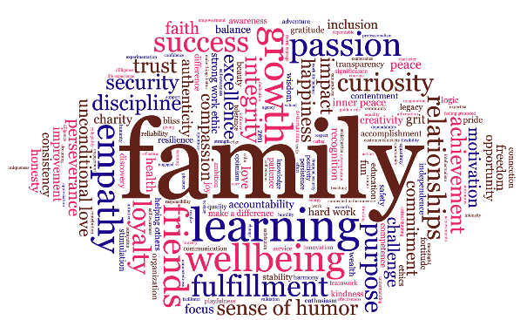

Slide 3
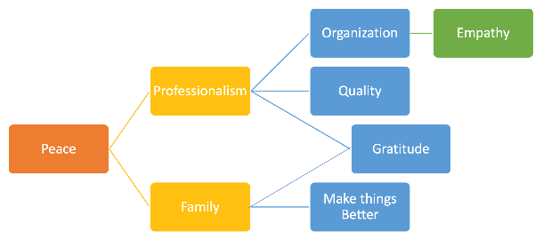
Mohit Agarwal

Slide 5
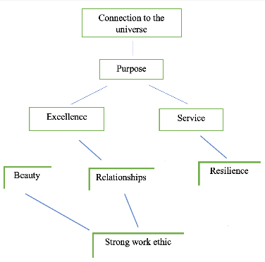
Jamie Bergos

Slide 7
Jeremy Browning
respect
legacy
beauty
health
family
knowledge
achievement
Self awareness

Slide 9
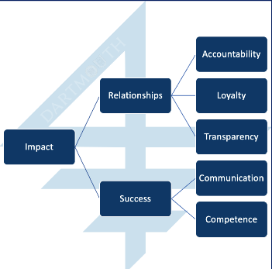
Helena Darling

Slide 11
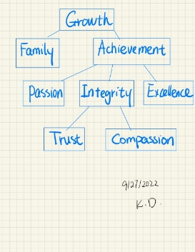
Ke Ding
Notes:
手写体
Wrong link:
Passion => integrity & family
Excellent => integrity

Slide 13
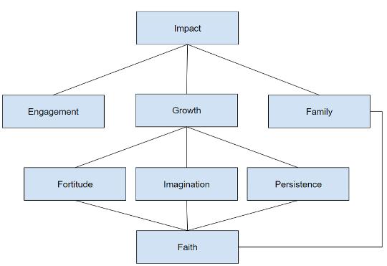
Joel Dmello

Slide 15
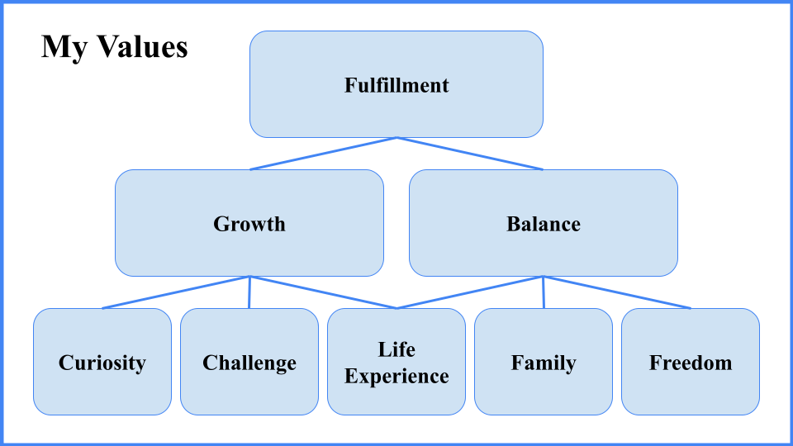
Thomas Donegan

Slide 17
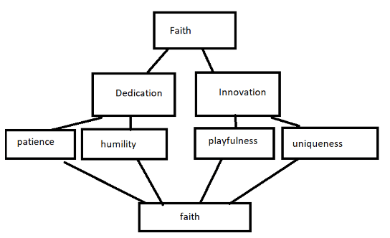
Grace Han

Slide 19
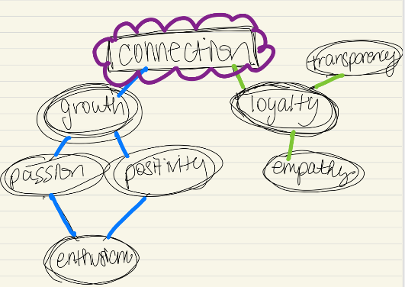
Rachel Horton

Slide 21
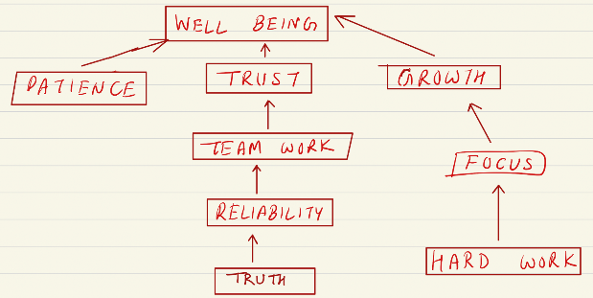
Vishal Jalan
Notes:
9AT+ENCE => Patience

Slide 23
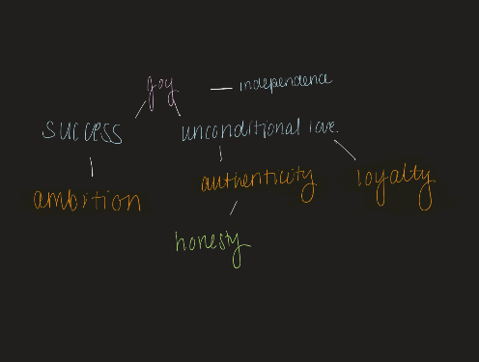
Dina Kassem

Slide 25
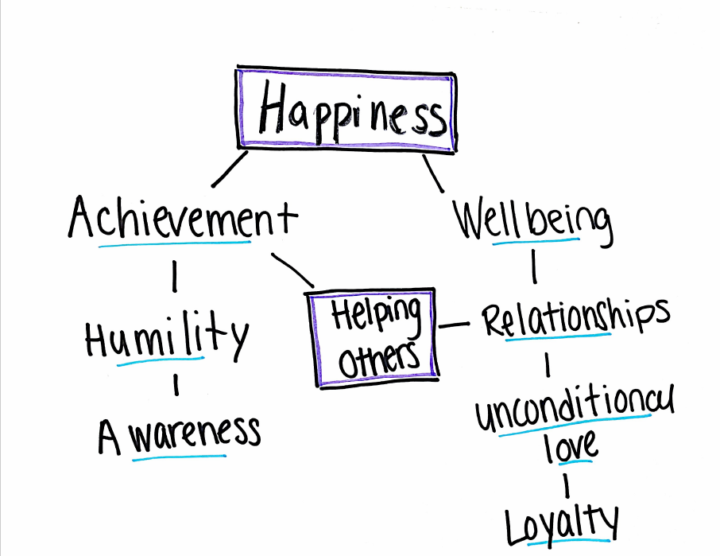
Sonia Kumar

Slide 27
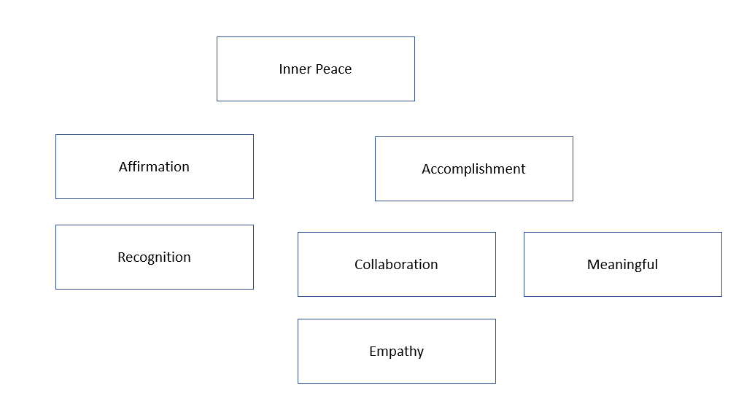
Hyeong Jin Kwon

Slide 29
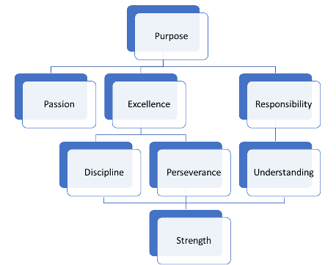
John Lynch

Slide 31
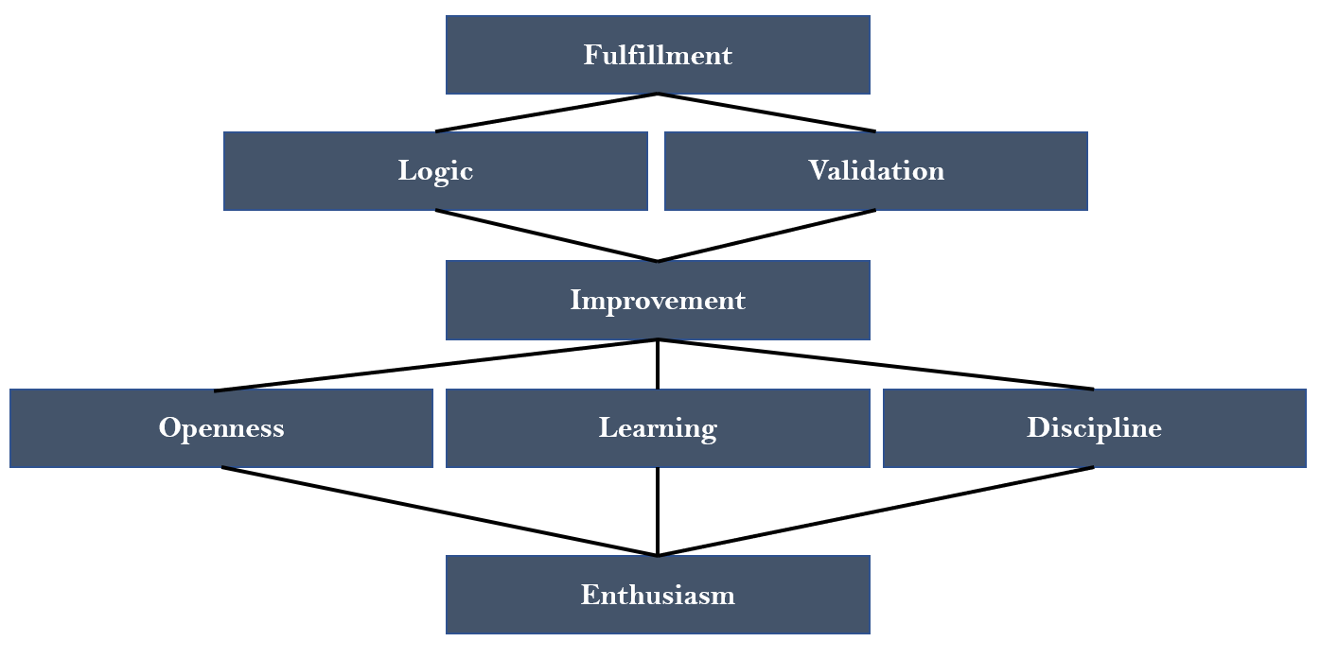
Thomas Marra

Slide 33
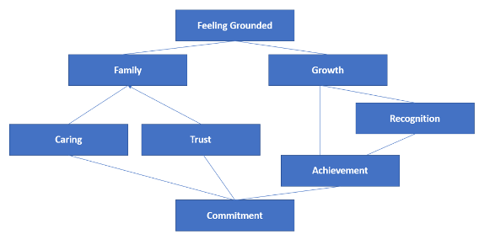
Joanna Mieczkowska

Slide 35
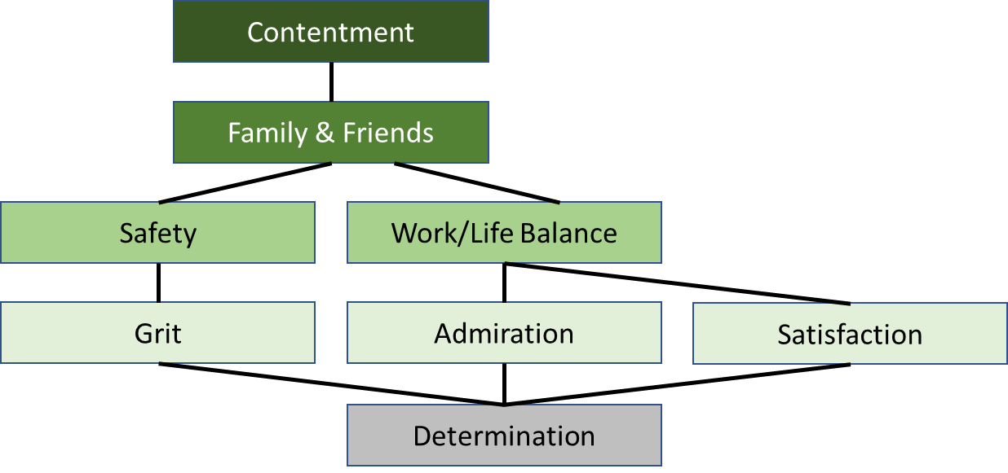
Jeffrey Moya

Slide 37
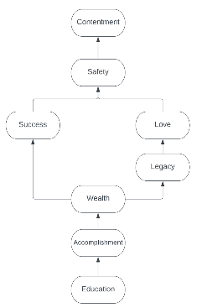
Aman S. Mundra

Slide 39
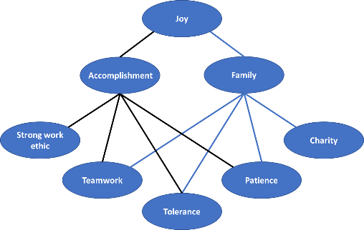
Christopher Novak

Slide 41
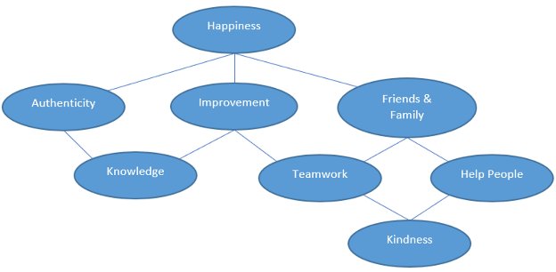
Connor O’Neill

Slide 43
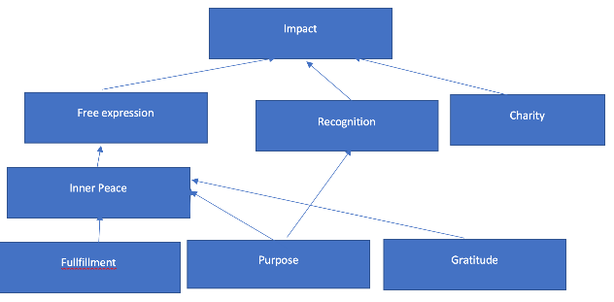
Khushtar Pandit

Slide 45
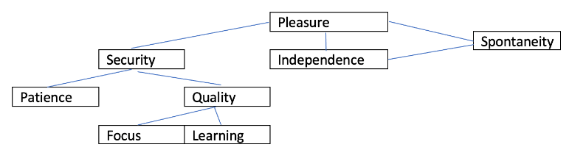
James Pilkington

Slide 47
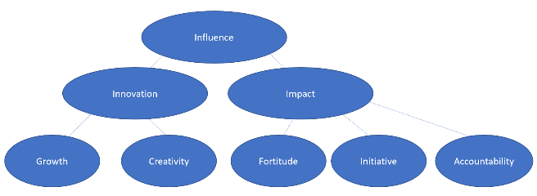
Mike Pisani
Notes:
圆形边框 => 线条读取混乱 => 关系匹配有误

Slide 49
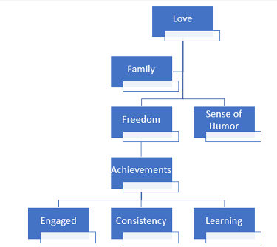
Jake Recker

Slide 51
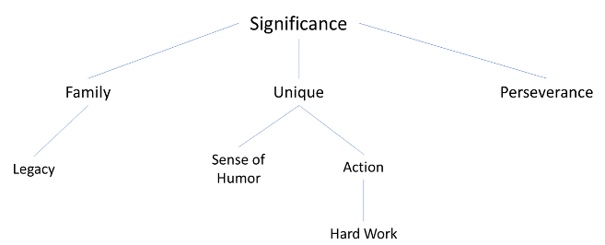
Sunny Reddy

Slide 53
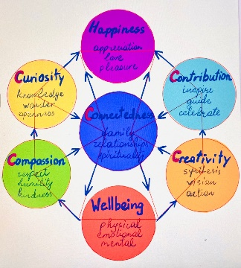
Anush Ricci

Slide 55
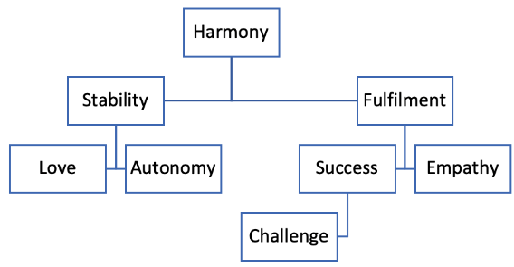
Abigail Richardson

Slide 57
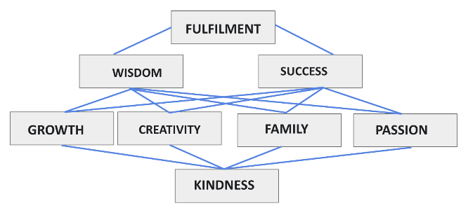
Gintare Rudyte

Slide 59
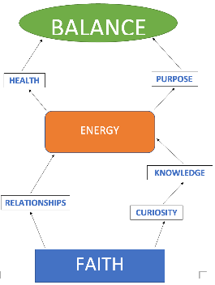
Gurvinder Sethi

Slide 61
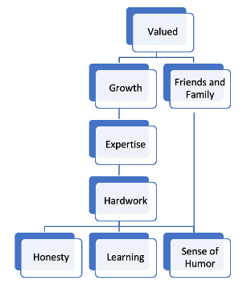
Gaurav Sharma
Gaurav

Slide 63
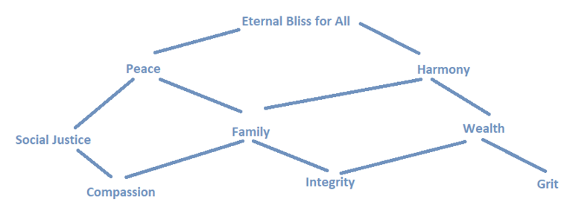
Vibha Singh

Slide 65
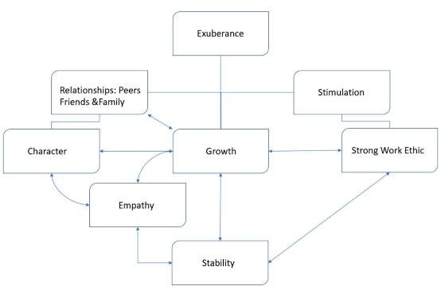
Avery Toland

Slide 67
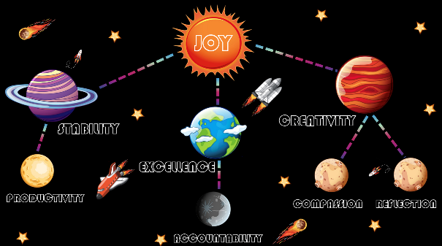
Blake Tomnitz

Slide 69
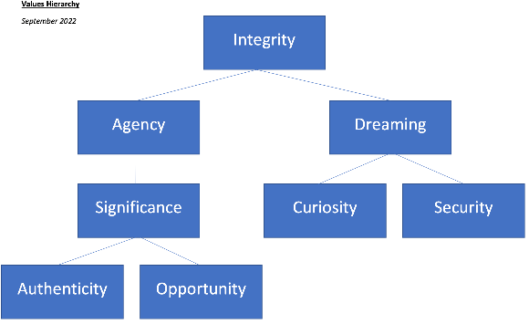
Dan Valladares

Slide 71
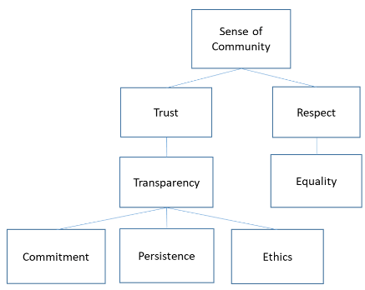
Paulo Humberto Varnieri

Slide 73
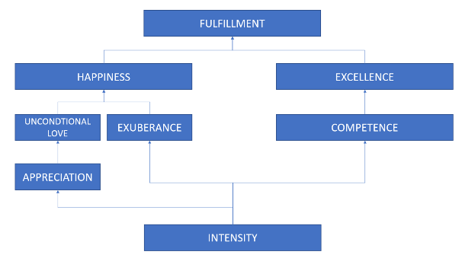
Jake Weiss

Slide 75
Hugo Fausto Torres-Fetsco
Optimism
Work-life-balance
Critical Thinking
Freedom
Making things better
Laughter
Mentoring
Spirituality

Slide 77
Toka Akiyama
Work-life balance
Connected
Generosity
Grit
Charity
Grace
Learning
Excellence

Slide 79
Lorea Amatria Senar
Love
Humanity
Friends
Family
Empathy
Improvement
Difference
Optimism

Slide 81
Jack Barrow
Happiness
Family
Success
Justice
Freedom
Stimulation
Integrity
Kindness

Slide 83
Mike Borges
Optimism
Camaraderie
Work ethic
Passion
Golden rule
Dependable
Curiosity

Slide 85
Emily Crandall
Bliss
Make a difference
Growth
Teaching
Diligence
Moral Courage
Empathy
Motivation

Slide 87
Brendan Davis
Love
Validation
Family
Excellence
Resilience
Max income
Ambition
Pride

Slide 89
Ricardo Doddoli
Inner peace
Impact
Family
Opportunity
Support
Purpose
Motivation
Self- Esteem

Slide 91
Lauren Eckstrom
Gratitude
Warmth
Happiness
Playfulness
Unconditional Love
Family
Perseverance
Golden rule

Slide 93
Lauren Flanagan
Bliss
Growth
Balance
Empathy
Wellbeing
Communication
Listening
Self-awareness

Slide 95
Lindsey Gitlin
Contentment
Accomplishment
Friends/ Family
Learning
Story with
ethic
Fun
Dependability
Adventure

Slide 97
Ian Glassford
Make a difference/impact
Challenge
Education
Balance
Creativity
Diligence
Flexibility
Inclusion

Slide 99
Arun Hemrajani
Happiness
Trust
Security
Love
Loyalty
Humor
Passion
Authenticity

Slide 101
Samuel Hutchins
Gratitude
Family
Wisdom
Commitment
Consistency
Critical thinking
Awareness
Effort

Slide 103
Gurpreet Kaur
Peace
Friends & Family
Gratitude
Reliability
Dedication
Consistency
Opportunity
Hard work

Slide 105
Stacy Kramer
Happiness
Family + Friends
Social justice
Health
Empathy
Impact
Learning
Passion + Purpose

Slide 107
Brandon Lawrence
Harmony
Fun
Empowerment
Discovery
Change
Tolerance
Logic
Discipline

Slide 109
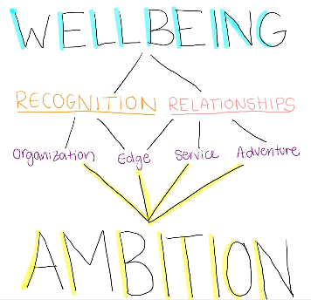
Alexandra Martin

Slide 111
Daniel Matusov
Contentment
Achievement
Family
Adventure
Learning
Compassion
Integrity

Slide 113
Kyle McNicholas
Impact
Help people
Excellence
Ethical
Persistence
Transparency
Challenge
Accountability

Slide 115
Jean Melo
Inner peace
Success
Integrity
Empathy
Growth
Optimism
Resilience
Family

Slide 117
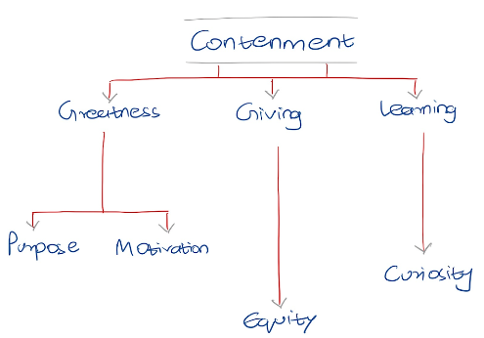
Sanket Parab

Slide 119
Vinh Nguyen
Zen
Satisfaction
Friends & Family
Ovality Discipline
Customer Centricity
Caring
Integrity

Slide 121
Stephanie Pardoe
Equanimity
Wisdom
Compassion
Impact
Acknowledgment
Collegiality
Help
people
Faith

Slide 123
Sara Pena
Honesty
Motivation
Growth
Hard
work
Determination
Make a
difference
Empathy
Family

Slide 125
Mike Piscadlo
Joy
Authenticity
Empathy
Financial
Security
Playfulness
Integrity
Loyalty
Hard work

Slide 127
George Sereika
Growth
Learning
Security
Energy
Fun
Recognition
Accountability
Relationships

Slide 129
Ankit Shrivastava
Wisdom
Do the right thing
Compassion
Customer-centricity
Tolerance
Giving
Curiosity
Experimentation

Slide 131
Ashley Sohier
Growth
Family
Dependability
Integrity
Communication
Thinking
Fun
Discipline

Slide 133
Kaelin Sprawls
Connection
Stability
Kindness
Relationships
Well being
Fun
Enthusiasm
Commitment

Slide 135
Mia Stender
Security
Agency
Impact
Resolve
Balance
Inclusion
Service
Community

Slide 137
Benjamin Tsujiura
Fulfillment
Reliability
Growth
Legacy
Passion
Relationships
Family
Positivity

Slide 139
Kendrick Van Doorn
Inner Peace/ Satisfied
Effectiveness
Authenticity
Empathy
Learning
Faccilator
Listening
Inclusion

Slide 141
Amy Wechsler
Well-being
Make a difference
Family
Excellence
Empathy
Compassion
Resilience
Reflection

Slide 143
Tianshi Xie
Well being
Confidence
Excellence
Learning
Diligence
Innovation
Focus
Motivation

Slide 145
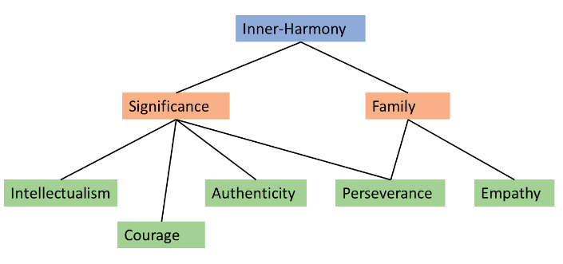
Junshu Zhao
Diligence
Innovation

